Slide 1


DATADOSE
Real-Time Drug Interaction Streaming Pipeline
Kafka → PySpark → Neo4j → Snowflake

Slide 2

Agenda
Business Problem & Safety
Risk Scoring Logic
Technology Stack
Snowflake Integration
Architecture & Pipeline
Monitoring & Debugging
Neo4j Enrichment Engine
Summary & Best Practices

Slide 3





The Business Imperative
Patient Safety
Real-Time Detection
Clinical Decisions
Preventing adverse drug events (ADEs) before they occur by analyzing prescriptions in flight.
Empowering healthcare providers with automated severity flags: Major, Moderate, and Minor.
Traditional batch analysis misses the critical window for intervention during the prescription cycle.

Slide 4


Project Overview
Safety First. Data Always.
DataDose acts as a real-time clinical sentinel. By streaming prescription events through a graph-based enrichment engine, we provide sub-second risk intelligence.
•
High-throughput ingestion via managed Kafka.
•
Graph-traversal interaction checks in Neo4j.
•
Unified patient risk scoring engine.
•
Compliance-ready storage in Snowflake.

Slide 5
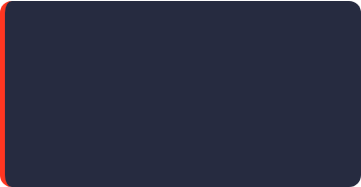
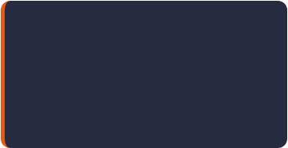
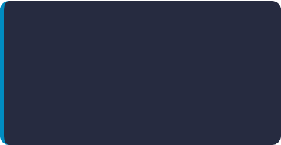


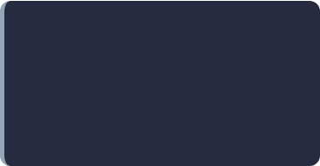
Enterprise Technology Stack
Kafka (Aiven)
Spark (Azure)
Neo4j AuraDB
Low-latency message broker for JSON prescription events.
PySpark Structured Streaming on Databricks clusters.
Cloud-native graph DB for complex relationship lookups.
Snowflake
Python 3.x
DB Secrets
Target warehouse for enriched transactional staging.
Primary logic and orchestration runtime environment.
Encrypted credentials via Databricks Secret Scopes.

Slide 6
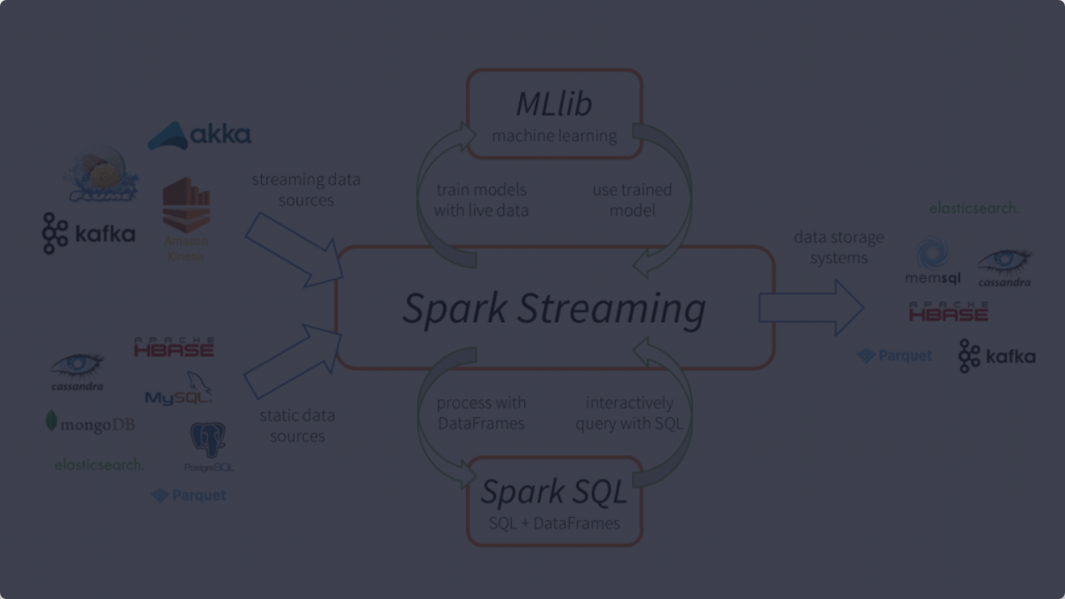


System Architecture
DataDose.in → Spark Streaming → foreachBatch()
Ingestion
Enrichment
Output
Managed Kafka consumes SASL_SSL SCRAM-SHA-256 events.
Neo4j Graph Traversal for drug-to-drug & ingredient overlaps.
Enriched rows land in Snowflake STG_TRANSACTION (Append Mode).

Slide 7
Streaming Pipeline Lifecycle
KAFKA TOPIC
ENRICHMENT
Aiven Message Broker
Graph lookup & Scoring
PRODUCER
CONSUMER
SNOWFLAKE
JSON Events
Spark Structured Stream
Append Staging

Slide 8

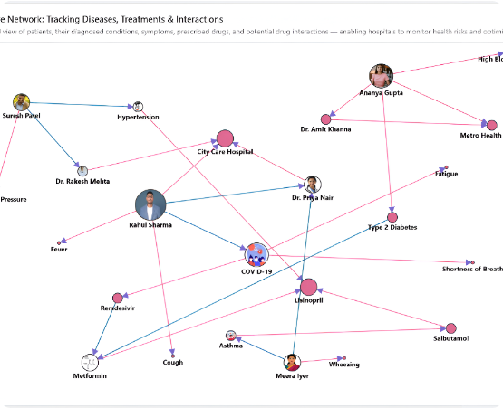

Neo4j Drug Interaction Engine
Relationship Mapping
INTERACTS_WITH: Links Drugs to detect contraindications.
HAS_INGREDIENT: Detects shared active agents.
SEVERITY: Major, Moderate, Minor metadata retrieval.

Slide 9
Real-Time Risk Scoring Logic
60
Scoring Components
Severity: Major(40), Moderate(20), Minor(10)
HIGH RISK THRESHOLD
Polypharmacy: +5 if medications ≥ 5
Age Multiplier: 1.0 + (Age - 40) * 0.005
Result → PATIENT_RISK_SCORE

Slide 10
Snowflake Staging Integration
Object | Setting | Role / Mode
Database | PHARMA_ANALYTICS_DB | Central Repository
Schema | STAGING | Raw Landing Zone
Table | STG_TRANSACTION | Append Mode
Warehouse | PHARMA_WH | Scalable Compute
Role | PYSPARK_ROLE | Secure Access

Slide 11



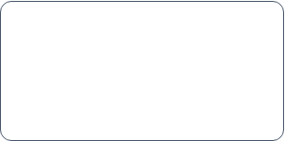
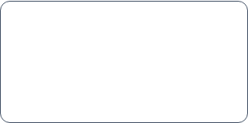
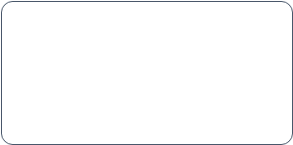
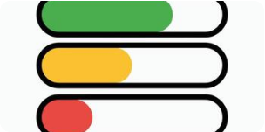
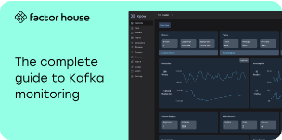

Operational Monitoring Dashboard
Connectivity
Stream Health
Validation
Kafka & Neo4j pings verified in Step 3.
Active query progress monitoring (Step 9).
Automatic JSON schema enforcement (Step 6).

Slide 12




Configuration & Security
Secrets Management
Auth Protocols
Usage of Databricks Secret Scopes (datadose) ensures zero plain-text passwords in source code.
•
Kafka: SASL_SSL (SCRAM-SHA-256)
•
Neo4j: URI with Auth Token
•
Snowflake: User/Pass Auth

Slide 13
Pipeline Execution Timeline
Step 1-4
Step 7
Config & Conn
Batch Logic
Step 0
Step 5-6
Step 8-9
Install Drivers
Schema & Stream
Start & Monitor

Slide 14
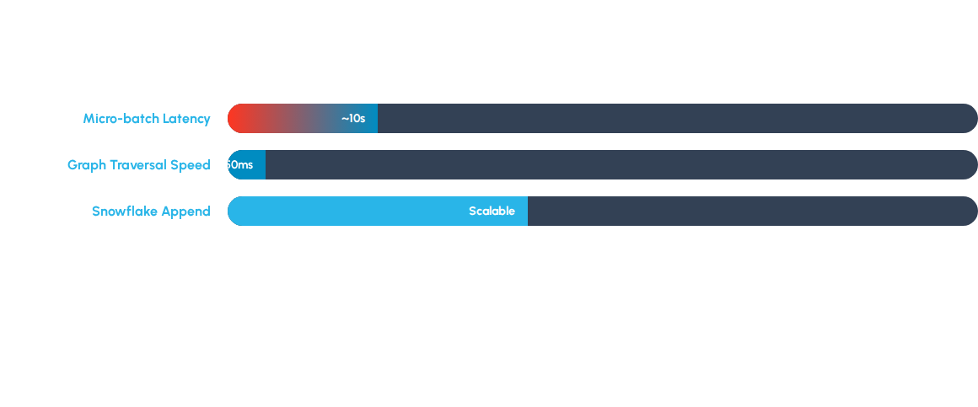
Performance & Reliability
Fault tolerance ensured via DBFS Checkpointing & ForeachBatch atomic commits.

Slide 15



Engineering Best Practices
Resilience
Security
Observability
Checkpointing allows the stream to resume exactly where it left off after any cluster failure.
Isolation of credentials using Secret Scopes and SCRAM-SHA-256 encrypted transit.
17 distinct Debug cells provide granular insight into connectivity, schema, and processing health.

Slide 16


Integration inside DataDose
Module Ecosystem
DATA FLOW VELOCITY
This pipeline is the "nervous system" of DataDose, connecting raw ingestion to the analytical brain.
•
Input: Prescription Cleaning Pipeline
•
Knowledge: Neo4j Master Graph
•
Storage: Snowflake Global Warehouse
•
UI: Power BI & Clinical Dashboard

Slide 17


Project Summary
Technical Achievements
Future Scalability
•
Successful Aiven-Databricks-Neo4j handshake.
•
Extensible to higher volume medication streams.
•
Automated severity-weighted risk engine.
•
Potential for ML integration in Risk Scoring.
•
Scalable Structured Streaming design.
•
Direct feed to real-time clinical alerts.

Slide 18
Thank You!
Questions & Discussion
DataDose Project: Real-Time Drug Interaction Pipeline
Databricks • Kafka • Neo4j • Snowflake

Slide 19






Image Sources
https://img.freepik.com/premium-photo/abstract-illustration-medical-equipment-symbols-data-visualizations_717577-38698.jpg
Source: www.freepik.com
https://inforiver.com/wp-content/uploads/power-bi-network-graph-node-format-by-level-source-target.png
Source: inforiver.com
https://static.vecteezy.com/system/resources/thumbnails/068/039/655/small/colorful-loading-progress-bars-in-green-yellow-and-red-flat-design-infographic-element-for-status-indicator-user-interface-dashboard-or-web-design-vector.jpg
Source: www.vecteezy.com
https://cdn.prod.website-files.com/689f8aab1977008c61538b01/6a1fe92879e952be610b9021_kafka%20monitoring.png
Source: factorhouse.io
https://static.vecteezy.com/system/resources/thumbnails/059/676/696/small/check-mark-icon-set-validation-symbols-tick-sign-illustrations-transparent-background-free-vector.jpg
Source: www.vecteezy.com
https://daxg39y63pxwu.cloudfront.net/images/blog/spark-streaming-example/image_795716530101640689003007.png
Source: www.projectpro.io

